Slide 1



Adversarial Robustness: A Tutorial
Samson Zhou

Slide 2


Why Adversarial Robustness?
Adversarial input
Contested environments
Notes:
Let’s start by breaking down each of the terms in the title. To understand the sliding window model, we first have to understand the streaming model of computation, in which elements of an underlying data set S, arrive sequentially and the goal is to evaluate or approximate some given function on this dataset, using space sublinear in S. In the sliding window model, only the W most recent updates form the underlying data set

Slide 3
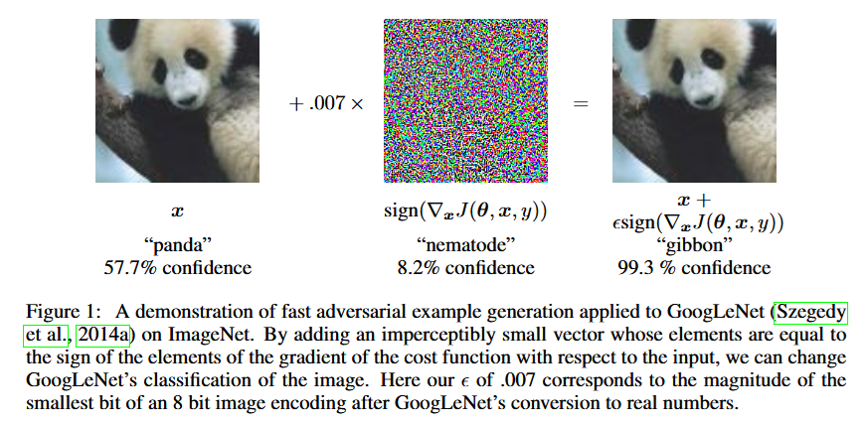
Why Adversarial Robustness?
Adversarial input
Adversarial ML
Notes:
Let’s start by breaking down each of the terms in the title. To understand the sliding window model, we first have to understand the streaming model of computation, in which elements of an underlying data set S, arrive sequentially and the goal is to evaluate or approximate some given function on this dataset, using space sublinear in S. In the sliding window model, only the W most recent updates form the underlying data set

Slide 4
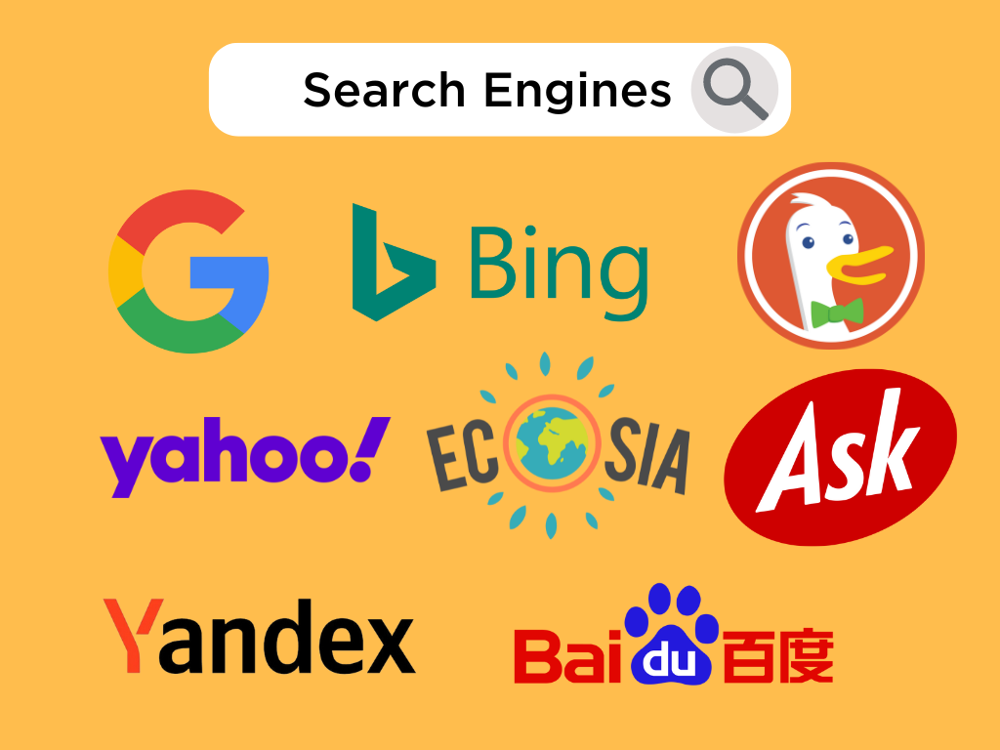
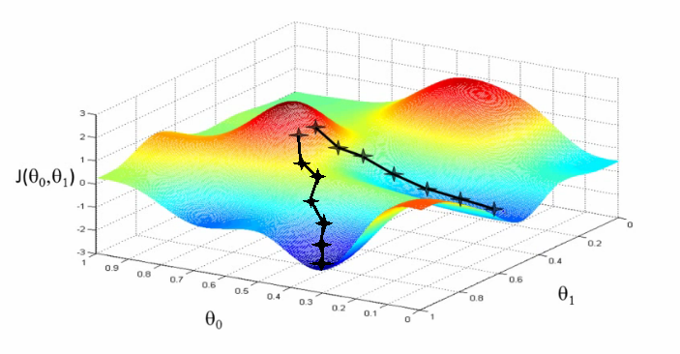

Why Adversarial Robustness?
Adaptive input
Repeated interactions
Database Queries
Stochastic Optimization
Financial Analytics
Notes:
Let’s start by breaking down each of the terms in the title. To understand the sliding window model, we first have to understand the streaming model of computation, in which elements of an underlying data set S, arrive sequentially and the goal is to evaluate or approximate some given function on this dataset, using space sublinear in S. In the sliding window model, only the W most recent updates form the underlying data set

Slide 5
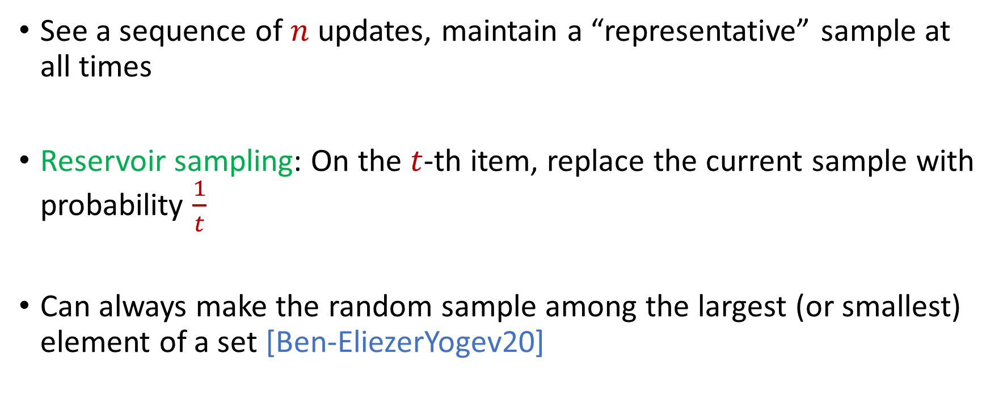
Sampling and Adversarial Input
See a sequence of $n$ updates, maintain a “representative” sample at all times
Reservoir sampling: On the $t$-th item, replace the current sample with probability $\frac{1}{t}$
Can always make the random sample among the largest (or smallest) element of a set [Ben-EliezerYogev20]
Notes:
Let’s start by breaking down each of the terms in the title. To understand the sliding window model, we first have to understand the streaming model of computation, in which elements of an underlying data set S, arrive sequentially and the goal is to evaluate or approximate some given function on this dataset, using space sublinear in S. In the sliding window model, only the W most recent updates form the underlying data set

Slide 6
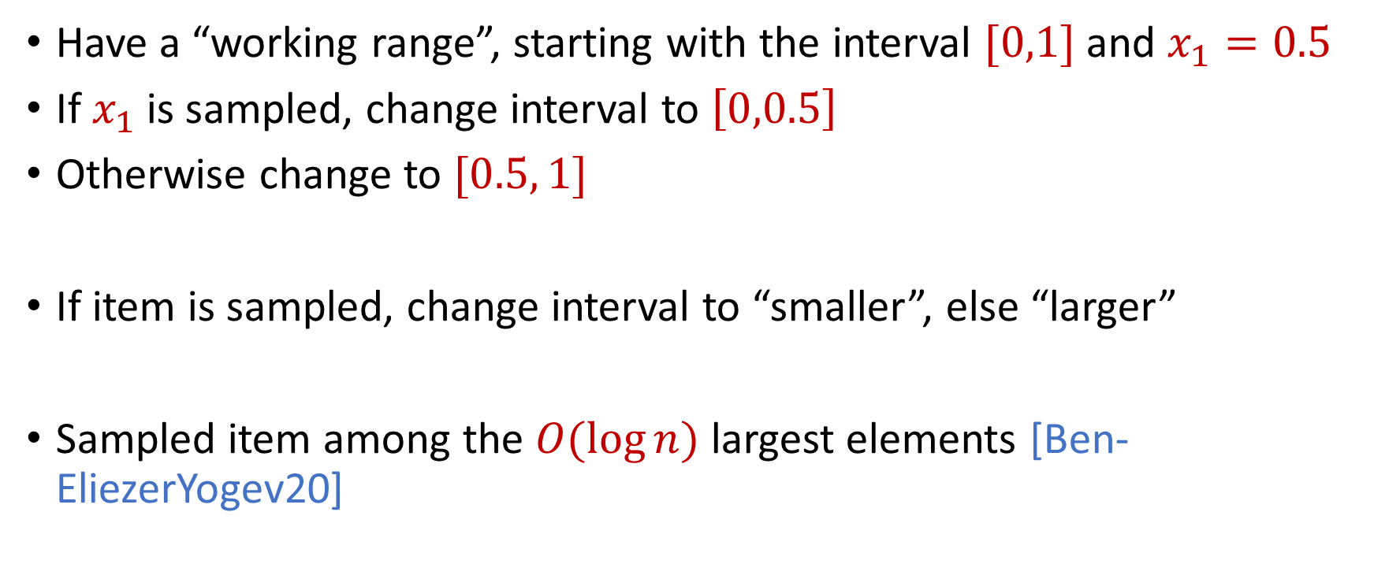
Sampling and Adversarial Input
Have a “working range”, starting with the interval $[0,1]$ and $x_{1}=0.5$
If $x_{1}$ is sampled, change interval to $\left[0,0.5\right]$
Otherwise change to $[0.5, 1]$
If item is sampled, change interval to “smaller”, else “larger”
Sampled item among the $O(\log{n})$ largest elements [Ben-EliezerYogev20]
Notes:
Let’s start by breaking down each of the terms in the title. To understand the sliding window model, we first have to understand the streaming model of computation, in which elements of an underlying data set S, arrive sequentially and the goal is to evaluate or approximate some given function on this dataset, using space sublinear in S. In the sliding window model, only the W most recent updates form the underlying data set

Slide 7
Upshot
Even fundamental primitives such as sampling are not robust!
Need new techniques
NEW Connections across many areas:
Sublinear algorithms
Differential privacy
Adaptive data analysis
Cryptography
Lattice theory
Notes:
Let’s start by breaking down each of the terms in the title. To understand the sliding window model, we first have to understand the streaming model of computation, in which elements of an underlying data set S, arrive sequentially and the goal is to evaluate or approximate some given function on this dataset, using space sublinear in S. In the sliding window model, only the W most recent updates form the underlying data set

Slide 8
Workshop Themes
What attacks are possible against classical data structure and algorithms? How efficient can we make them?
Xin, Mihir, Sara, Edith
What are the capabilities and limitations of robust data structures and algorithms in various models? How do different adversarial models change what’s possible?
Omri, Amit, Guy, David, Elena, Honghao
New problems and models of adversarial robustness
Uri, Binghui, Sandeep, Chen, Shenghao, Yuhan
Notes:
Let’s start by breaking down each of the terms in the title. To understand the sliding window model, we first have to understand the streaming model of computation, in which elements of an underlying data set S, arrive sequentially and the goal is to evaluate or approximate some given function on this dataset, using space sublinear in S. In the sliding window model, only the W most recent updates form the underlying data set

Slide 9

Model #1: Streaming Model
Input: Elements of an underlying data set $S$, which arrives sequentially
Output: Evaluation (or approximation) of a given function
Goal: Use space sublinear in the size $m$of the input $S$
1 0 1 1 1 0 0 1
Notes:
Let’s start by breaking down each of the terms in the title. To understand the sliding window model, we first have to understand the streaming model of computation, in which elements of an underlying data set S, arrive sequentially and the goal is to evaluate or approximate some given function on this dataset, using space sublinear in S. In the sliding window model, only the W most recent updates form the underlying data set

Slide 10
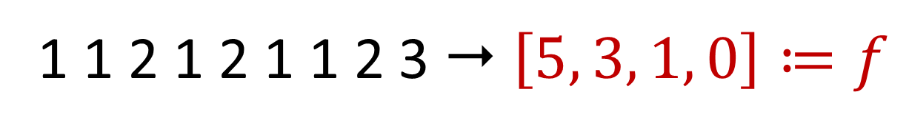

Frequency Vector
Given a set $S$ of $m$ elements from $[n]$, let $f_{i}$ be the frequency of element $i$. (How often it appears)
1 1 2 1 2 1 1 2 3  $\left[5, 3, 1, 0\right]≔f$

Slide 11
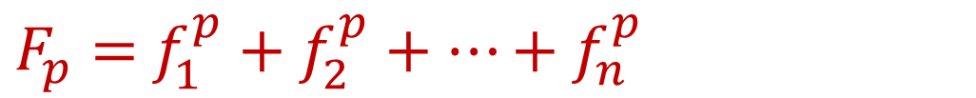
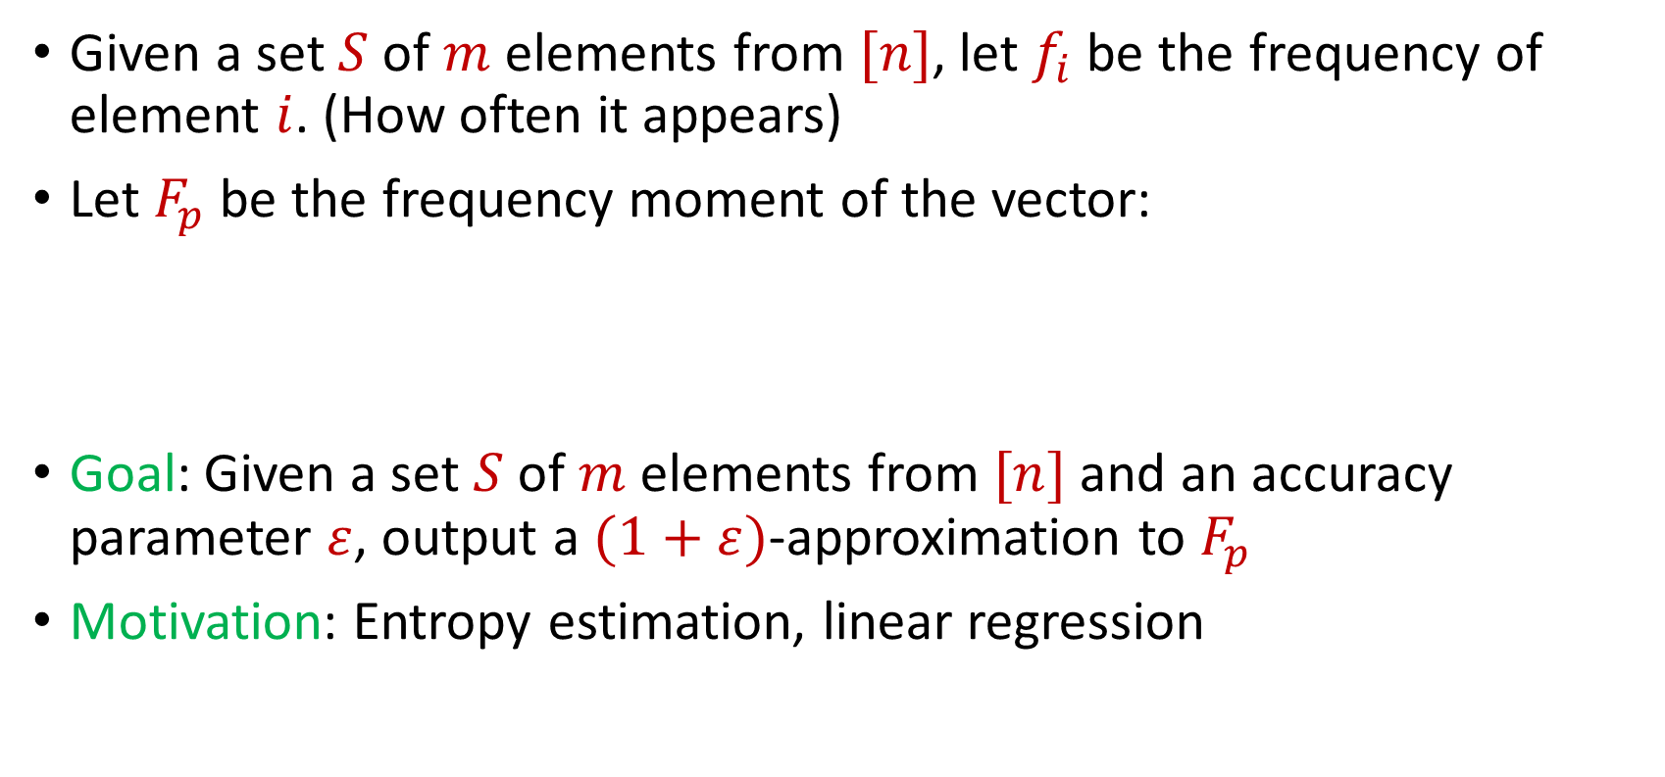
Frequency Moments
Given a set $S$ of $m$ elements from $[n]$, let $f_{i}$ be the frequency of element $i$. (How often it appears)
Let $F_{p}$ be the frequency moment of the vector:
Goal: Given a set $S$ of $m$ elements from $[n]$ and an accuracy parameter $ε$, output a $(1+ε)$-approximation to $F_{p}$
Motivation: Entropy estimation, linear regression
$F_{p}=$ $f_{1}^{p}+f_{2}^{p}+…+f_{n}^{p}$

Slide 12
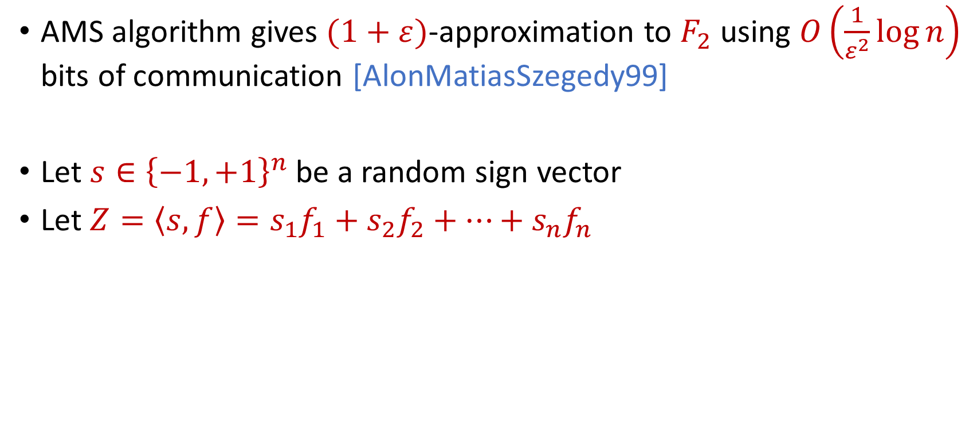
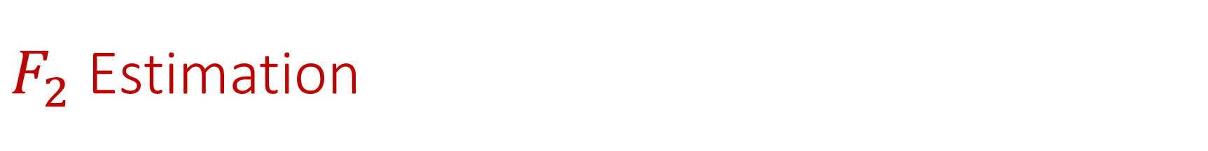
$F_{2}$ Estimation
AMS algorithm gives $(1+ε)$-approximation to $F_{2}$ using $O\left(\frac{1}{ε^{2}}\log{n}\right)$ bits of communication [AlonMatiasSzegedy99]
Let $s∈{\left\{−1,+1\right\}}^{n}$ be a random sign vector
Let $Z=\left\langle s,f\right\rangle =s_{1}f_{1}+s_{2}f_{2}+…+s_{n}f_{n}$

Slide 13
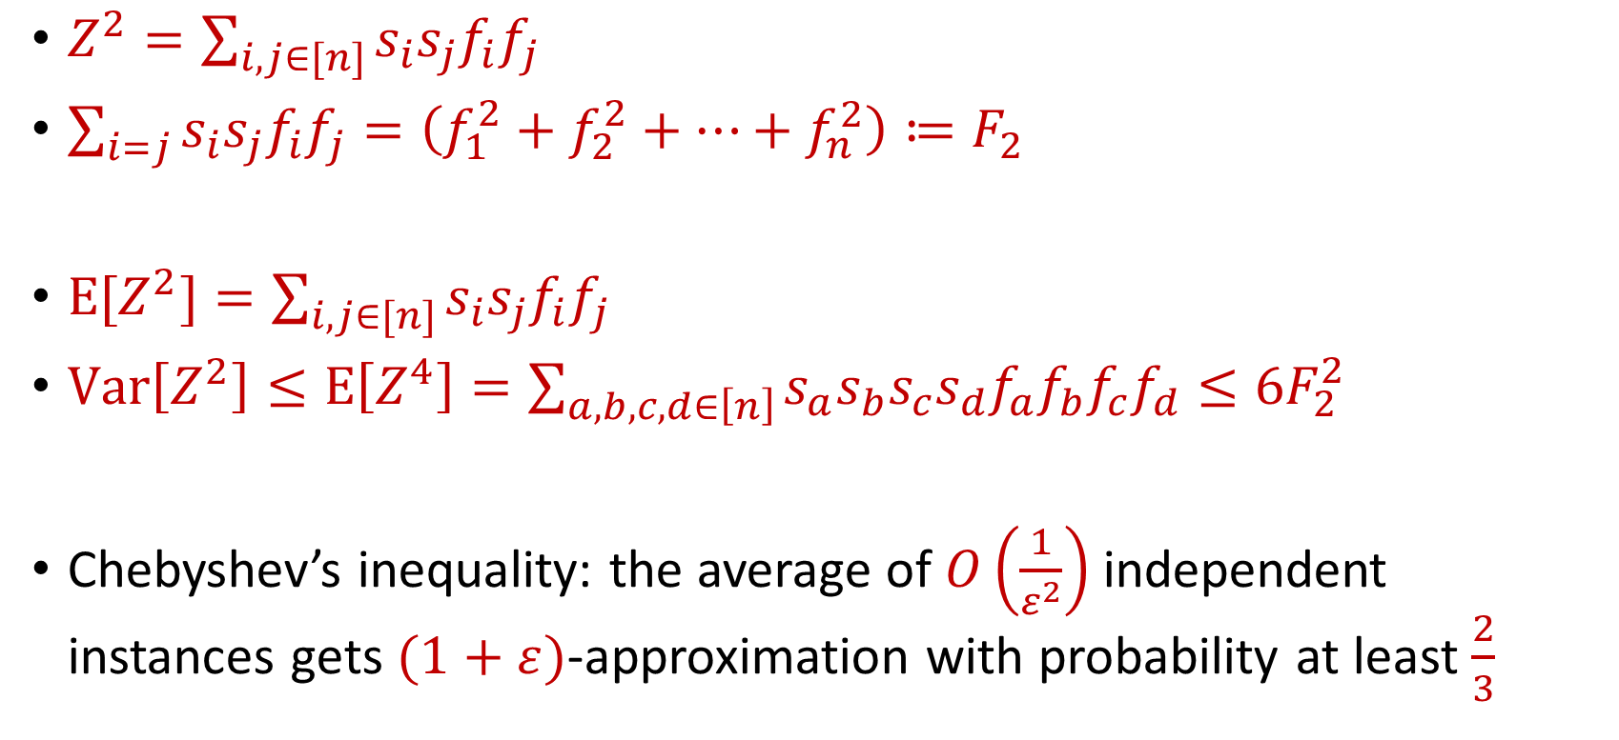
AMS Algorithm
$Z^{2}=\sum_{i,j∈[n]}{s_{i}s_{j}f_{i}f_{j}}$
$\sum_{i=j}{s_{i}s_{j}f_{i}f_{j}}=\left(f_{1}^{2}+f_{2}^{2}+…+f_{n}^{2}\right)≔F_{2}$
$E[Z^{2}]=\sum_{i,j∈[n]}{s_{i}s_{j}f_{i}f_{j}}$
$Var\left[Z^{2}\right]≤E\left[Z^{4}\right]=\sum_{a,b,c,d∈\left[n\right]}{s_{a}s_{b}s_{c}s_{d}f_{a}f_{b}f_{c}f_{d}}≤6F_{2}^{2}$
Chebyshev’s inequality: the average of $O\left(\frac{1}{ε^{2}}\right)$ independent instances gets $(1+ε)$-approximation with probability at least $\frac{2}{3}$

Slide 14
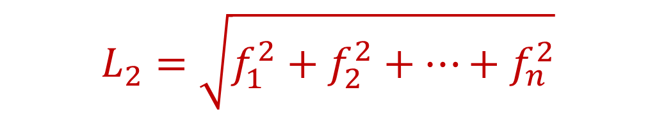
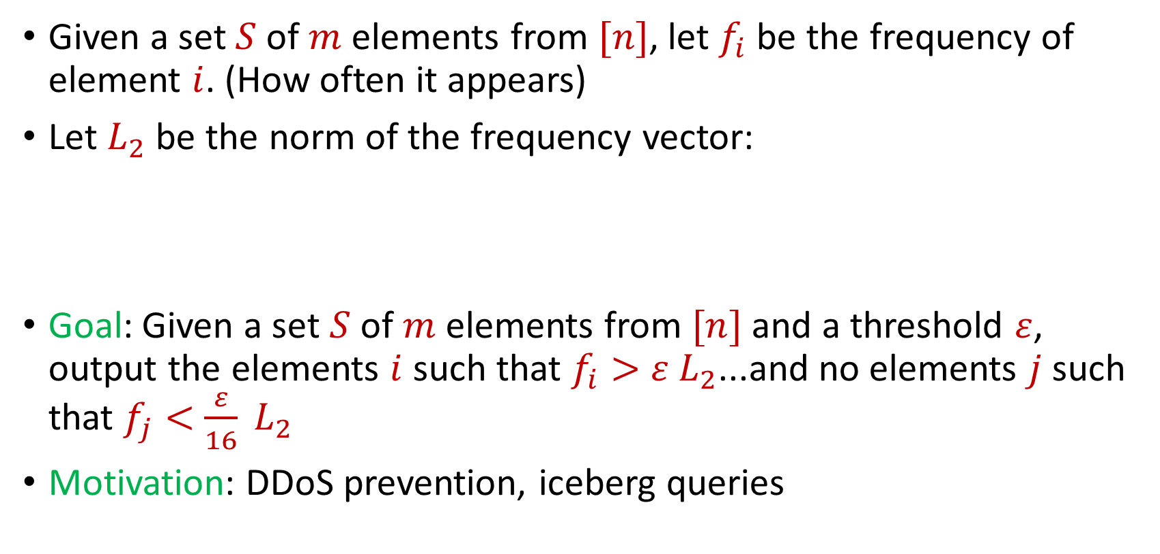
Heavy-Hitters
Given a set $S$ of $m$ elements from $[n]$, let $f_{i}$ be the frequency of element $i$. (How often it appears)
Let $L_{2}$ be the norm of the frequency vector:
Goal: Given a set $S$ of $m$ elements from $[n]$ and a threshold $ε$, output the elements $i$ such that $f_{i}>$ $ε L_{2}$...and no elements $j$ such that $f_{j}<$ $\frac{ε}{16} L_{2}$
Motivation: DDoS prevention, iceberg queries
$$L_{2}=\sqrt{f_{1}^{2}+f_{2}^{2}+…+f_{n}^{2}}$$

Slide 15
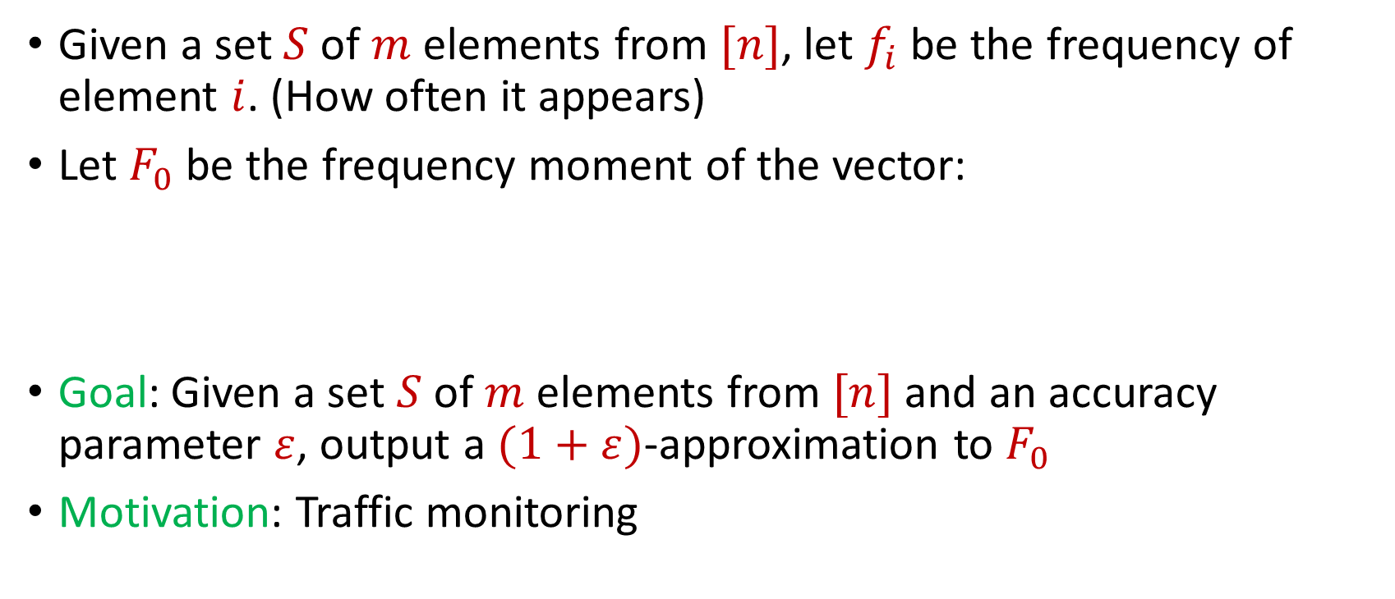
Distinct Elements
Given a set $S$ of $m$ elements from $[n]$, let $f_{i}$ be the frequency of element $i$. (How often it appears)
Let $F_{0}$ be the frequency moment of the vector:
Goal: Given a set $S$ of $m$ elements from $[n]$ and an accuracy parameter $ε$, output a $(1+ε)$-approximation to $F_{0}$
Motivation: Traffic monitoring
$F_{0}=$ $|\{i :f_{i}≠0\}|$

Slide 16
More generally…
Subspace embeddings, regression, low-rank approximation, clustering, etc.
(Can be handled by sampling algorithms)

Slide 17
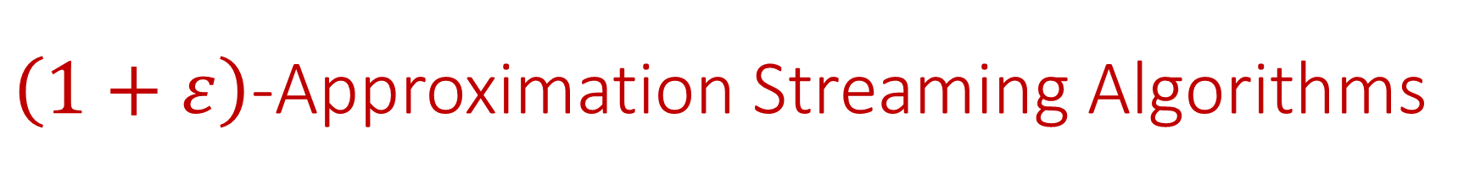
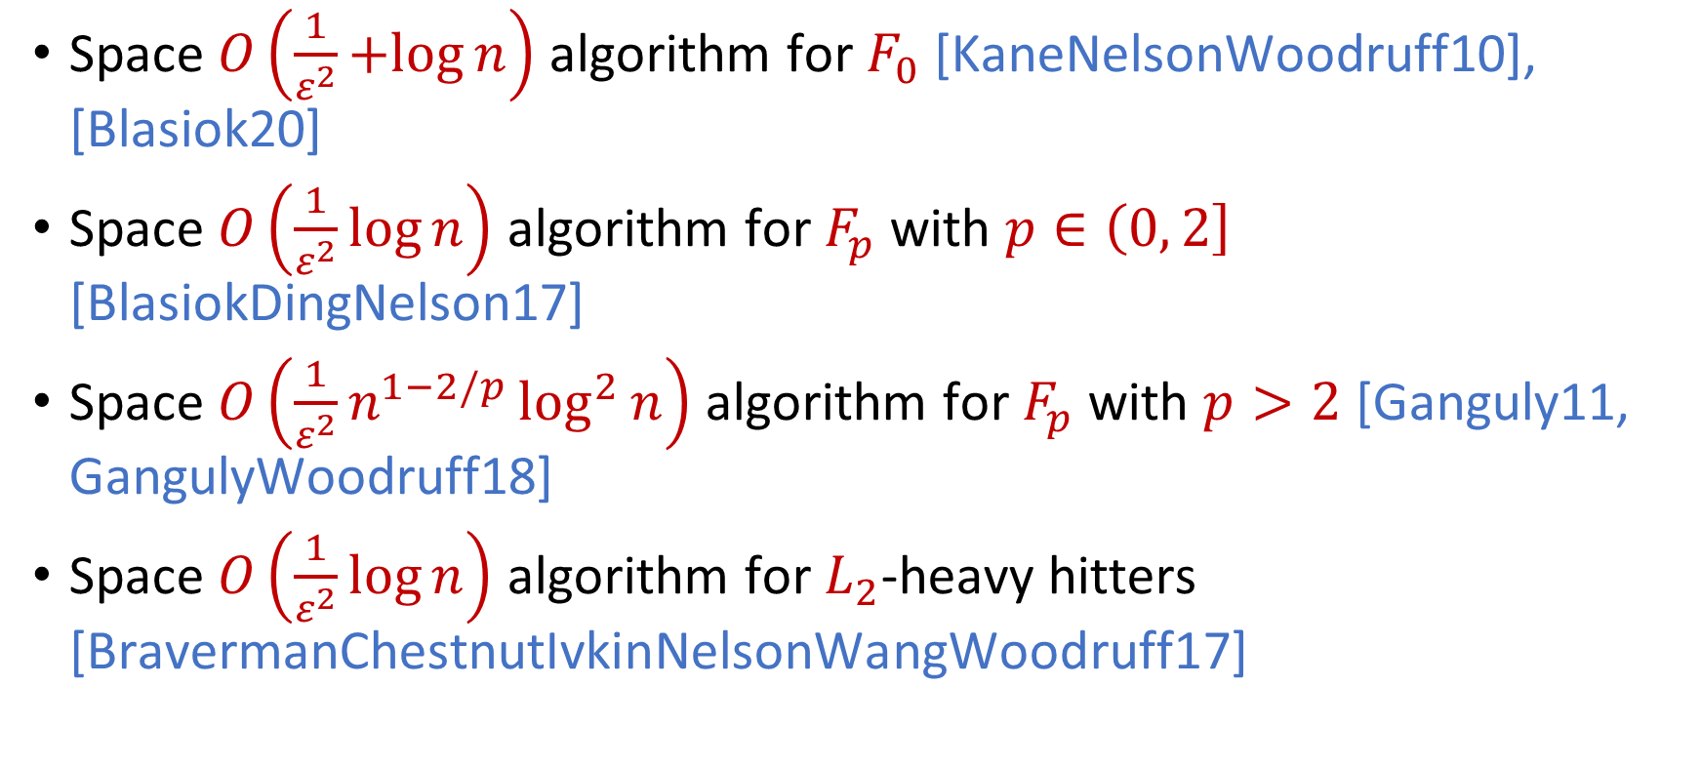
$\left(1+ε\right)$-Approximation Streaming Algorithms
Space $O\left(\frac{1}{ε^{2}}+log{n}\right)$ algorithm for $F_{0}$ [KaneNelsonWoodruff10], [Blasiok20]
Space $O\left(\frac{1}{ε^{2}}\log{n}\right)$ algorithm for $F_{p}$ with $p∈\left(0, 2\right]$ [BlasiokDingNelson17]
Space $O\left(\frac{1}{ε^{2}}n^{1−2/p}\log^{2}{n}\right)$ algorithm for $F_{p}$ with $p>2$ [Ganguly11, GangulyWoodruff18]
Space $O\left(\frac{1}{ε^{2}}\log{n}\right)$ algorithm for $L_{2}$-heavy hitters [BravermanChestnutIvkinNelsonWangWoodruff17]

Slide 18



Model #2: Adversarially Robust Streaming
Input: Elements of an underlying data set $S$, which arrives sequentially and adversarially
Output: Evaluation (or approximation) of a given function
Goal: Use space sublinear in the size $m$of the input $S$
1
1
Notes:
Let’s start by breaking down each of the terms in the title. To understand the sliding window model, we first have to understand the streaming model of computation, in which elements of an underlying data set S, arrive sequentially and the goal is to evaluate or approximate some given function on this dataset, using space sublinear in S. In the sliding window model, only the W most recent updates form the underlying data set

Slide 19
Model #2: Adversarially Robust Streaming
Input: Elements of an underlying data set $S$, which arrives sequentially and adversarially
Output: Evaluation (or approximation) of a given function
Goal: Use space sublinear in the size $m$of the input $S$
10
1
Notes:
Let’s start by breaking down each of the terms in the title. To understand the sliding window model, we first have to understand the streaming model of computation, in which elements of an underlying data set S, arrive sequentially and the goal is to evaluate or approximate some given function on this dataset, using space sublinear in S. In the sliding window model, only the W most recent updates form the underlying data set

Slide 20
Model #2: Adversarially Robust Streaming
Input: Elements of an underlying data set $S$, which arrives sequentially and adversarially
Output: Evaluation (or approximation) of a given function
Goal: Use space sublinear in the size $m$of the input $S$
101
2
Notes:
Let’s start by breaking down each of the terms in the title. To understand the sliding window model, we first have to understand the streaming model of computation, in which elements of an underlying data set S, arrive sequentially and the goal is to evaluate or approximate some given function on this dataset, using space sublinear in S. In the sliding window model, only the W most recent updates form the underlying data set

Slide 21
Model #2: Adversarially Robust Streaming
Input: Elements of an underlying data set $S$, which arrives sequentially and adversarially
Output: Evaluation (or approximation) of a given function
Goal: Use space sublinear in the size $m$of the input $S$
1010
3
Notes:
Let’s start by breaking down each of the terms in the title. To understand the sliding window model, we first have to understand the streaming model of computation, in which elements of an underlying data set S, arrive sequentially and the goal is to evaluate or approximate some given function on this dataset, using space sublinear in S. In the sliding window model, only the W most recent updates form the underlying data set

Slide 22

Model #2: Adversarially Robust Streaming
Input: Elements of an underlying data set $S$, which arrives sequentially and adversarially
Output: Evaluation (or approximation) of a given function
Goal: Use space sublinear in the size $m$of the input $S$
1010
3
Notes:
Let’s start by breaking down each of the terms in the title. To understand the sliding window model, we first have to understand the streaming model of computation, in which elements of an underlying data set S, arrive sequentially and the goal is to evaluate or approximate some given function on this dataset, using space sublinear in S. In the sliding window model, only the W most recent updates form the underlying data set

Slide 23
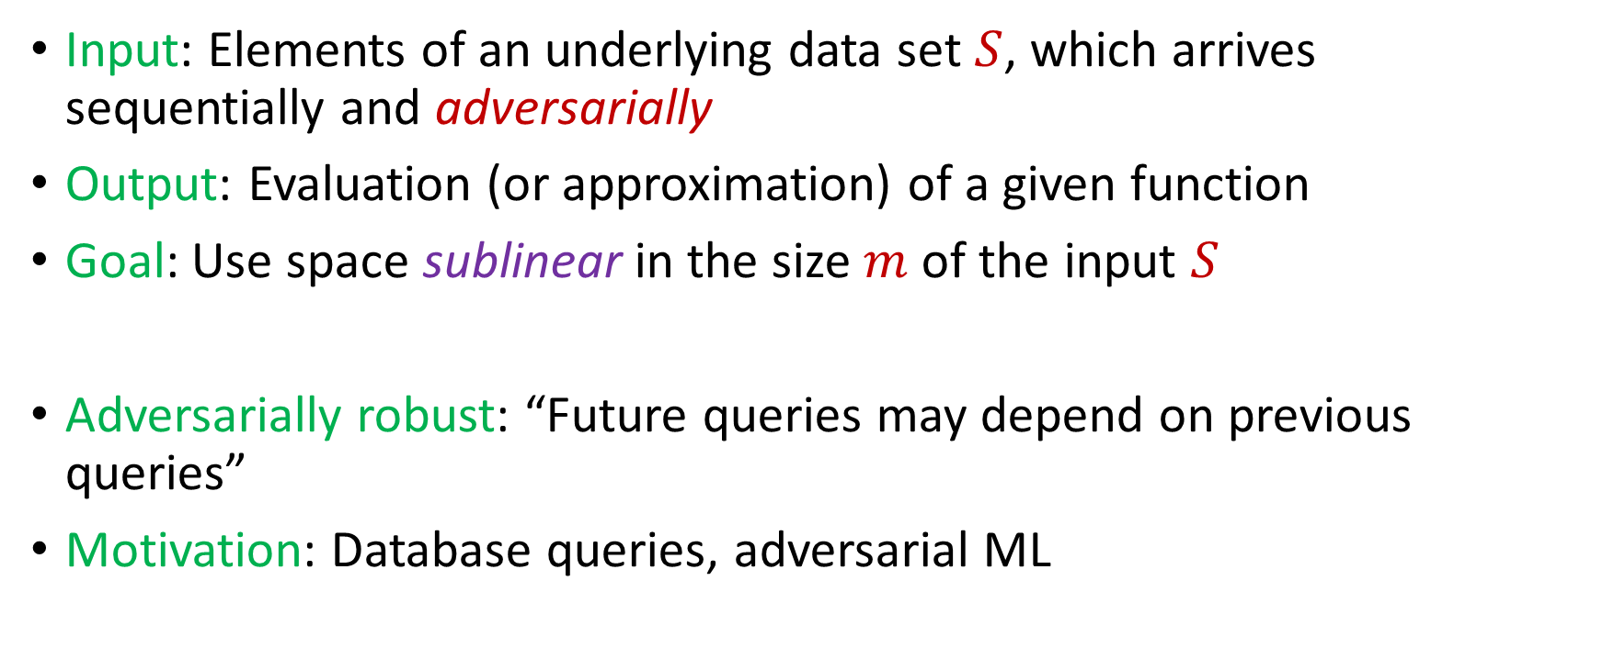
Model #2: Adversarially Robust Streaming
Input: Elements of an underlying data set $S$, which arrives sequentially and adversarially
Output: Evaluation (or approximation) of a given function
Goal: Use space sublinear in the size $m$of the input $S$
Adversarially robust: “Future queries may depend on previous queries”
Motivation: Database queries, adversarial ML
Notes:
Let’s start by breaking down each of the terms in the title. To understand the sliding window model, we first have to understand the streaming model of computation, in which elements of an underlying data set S, arrive sequentially and the goal is to evaluate or approximate some given function on this dataset, using space sublinear in S. In the sliding window model, only the W most recent updates form the underlying data set

Slide 24
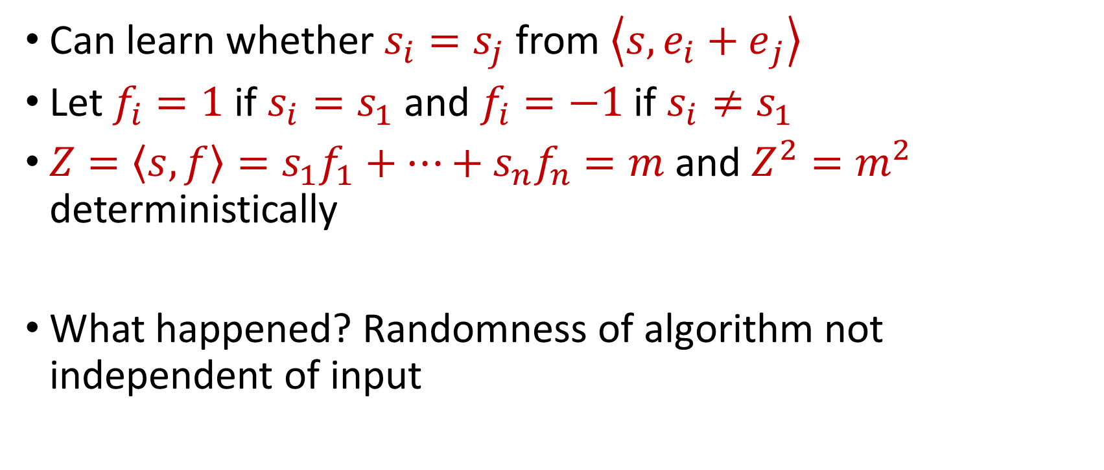
“Attack” on AMS
Can learn whether $s_{i}=s_{j}$ from $\left\langle s,{e_{i}+e}_{j}\right\rangle$
Let $f_{i}=1$ if $s_{i}=s_{1}$ and $f_{i}=−1$ if $s_{i}≠s_{1}$
$Z=\left\langle s,f\right\rangle =s_{1}f_{1}+…+s_{n}f_{n}=m$ and $Z^{2}=m^{2}$ deterministically
What happened? Randomness of algorithm not independent of input

Slide 25
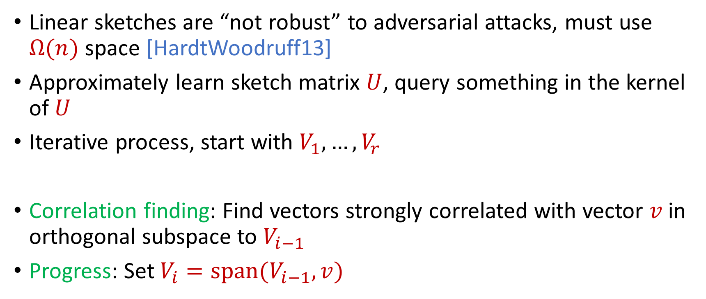
Reconstruction Attack on Linear Sketches
Linear sketches are “not robust” to adversarial attacks, must use $Ω(n)$ space [HardtWoodruff13]
Approximately learn sketch matrix $U$, query something in the kernel of $U$
Iterative process, start with $V_{1},…,V_{r}$
Correlation finding: Find vectors strongly correlated with vector $v$ in orthogonal subspace to $V_{i−1}$
Progress: Set $V_{i}=span(V_{i−1},v)$

Slide 26
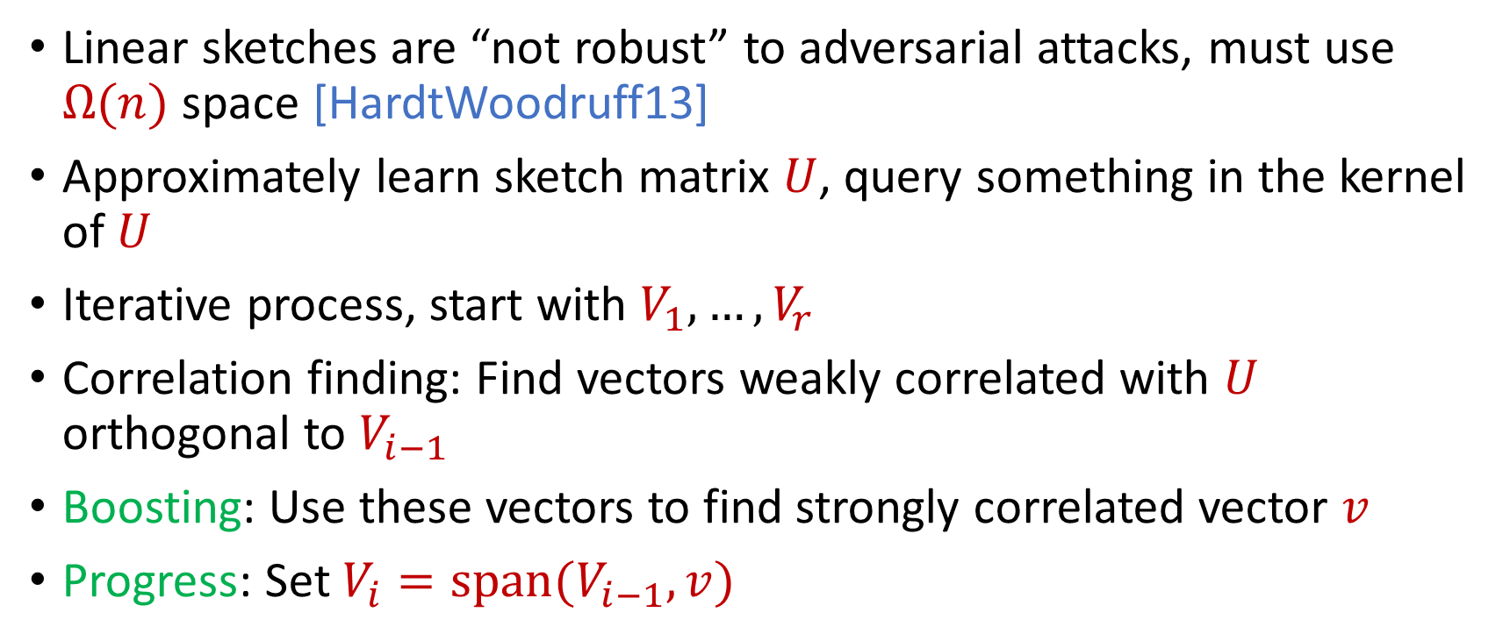
Reconstruction Attack on Linear Sketches
Linear sketches are “not robust” to adversarial attacks, must use $Ω(n)$ space [HardtWoodruff13]
Approximately learn sketch matrix $U$, query something in the kernel of $U$
Iterative process, start with $V_{1},…,V_{r}$
Correlation finding: Find vectors weakly correlated with $U$ orthogonal to $V_{i−1}$
Boosting: Use these vectors to find strongly correlated vector $v$
Progress: Set $V_{i}=span(V_{i−1},v)$

Slide 27
Insertion-Only Streams
Key: Deletions are needed to perform this attack
Assume insertion-only updates
How do the previous results work?

Slide 28
Robust Algorithms
Suppose we are trying to approximate some given function
Suppose we have a streaming algorithm for this function
Suppose this function is monotonic and the stream is insertion-only
Sketch switching framework [Ben-EliezerJayaramWoodruffYogev20] gives a robust for this function

Slide 29
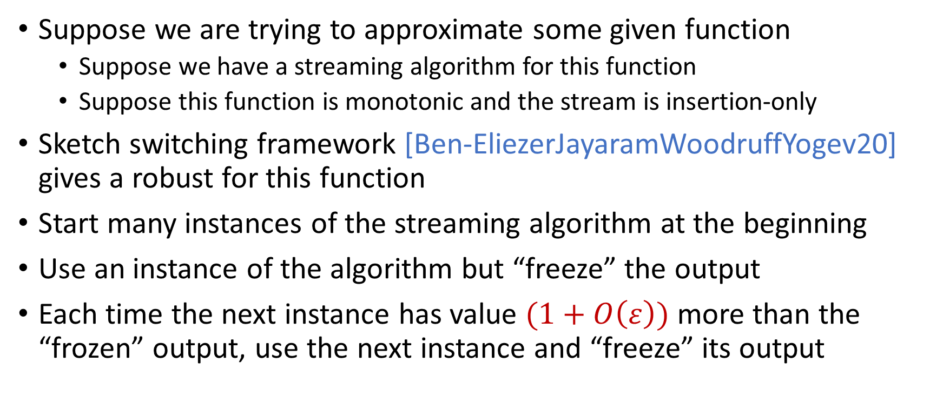
Robust Algorithms
Suppose we are trying to approximate some given function
Suppose we have a streaming algorithm for this function
Suppose this function is monotonic and the stream is insertion-only
Sketch switching framework [Ben-EliezerJayaramWoodruffYogev20] gives a robust for this function
Start many instances of the streaming algorithm at the beginning
Use an instance of the algorithm but “freeze” the output
Each time the next instance has value $(1+O\left(ε\right))$ more than the “frozen” output, use the next instance and “freeze” its output

Slide 30

Sketch Switching
Start many instances of the streaming algorithm at the beginning
Use an instance of the algorithm but “freeze” the output
Each time the next instance has value $(1+O\left(ε\right))$ more than the “frozen” output, use the next instance and “freeze” its output
1
Example: Number of ones in the stream (2-approximation)
1
1
1
1

Slide 31

Sketch Switching
Start many instances of the streaming algorithm at the beginning
Use an instance of the algorithm but “freeze” the output
Each time the next instance has value $(1+O\left(ε\right))$ more than the “frozen” output, use the next instance and “freeze” its output
1 0
Example: Number of ones in the stream (2-approximation)
1
1
1
1

Slide 32
Sketch Switching
Start many instances of the streaming algorithm at the beginning
Use an instance of the algorithm but “freeze” the output
Each time the next instance has value $(1+O\left(ε\right))$ more than the “frozen” output, use the next instance and “freeze” its output
1 0 1
Example: Number of ones in the stream (2-approximation)
1
2
2
2

Slide 33
Sketch Switching
Start many instances of the streaming algorithm at the beginning
Use an instance of the algorithm but “freeze” the output
Each time the next instance has value $(1+O\left(ε\right))$ more than the “frozen” output, use the next instance and “freeze” its output
1 0 1
Example: Number of ones in the stream (2-approximation)
1
2
2
2

Slide 34
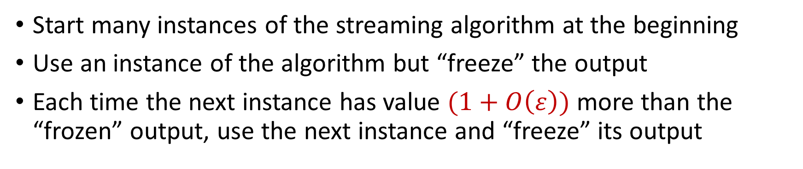
Sketch Switching
Start many instances of the streaming algorithm at the beginning
Use an instance of the algorithm but “freeze” the output
Each time the next instance has value $(1+O\left(ε\right))$ more than the “frozen” output, use the next instance and “freeze” its output
1 0 1 1
Example: Number of ones in the stream (2-approximation)
1
2
3
3

Slide 35
Sketch Switching
Start many instances of the streaming algorithm at the beginning
Use an instance of the algorithm but “freeze” the output
Each time the next instance has value $(1+O\left(ε\right))$ more than the “frozen” output, use the next instance and “freeze” its output
1 0 1 1 1
Example: Number of ones in the stream (2-approximation)
1
2
4
4

Slide 36
Sketch Switching
Start many instances of the streaming algorithm at the beginning
Use an instance of the algorithm but “freeze” the output
Each time the next instance has value $(1+O\left(ε\right))$ more than the “frozen” output, use the next instance and “freeze” its output
1 0 1 1 1
Example: Number of ones in the stream (2-approximation)
1
2
4
4

Slide 37
Sketch Switching
Start many instances of the streaming algorithm at the beginning
Use an instance of the algorithm but “freeze” the output
Each time the next instance has value $(1+O\left(ε\right))$ more than the “frozen” output, use the next instance and “freeze” its output
1 0 1 1 1 0 0 1 1 0 1
Example: Number of ones in the stream (2-approximation)
Number of ones stream is at least 4 and at most 8
4 is a good approximation
1
2
4
7

Slide 38
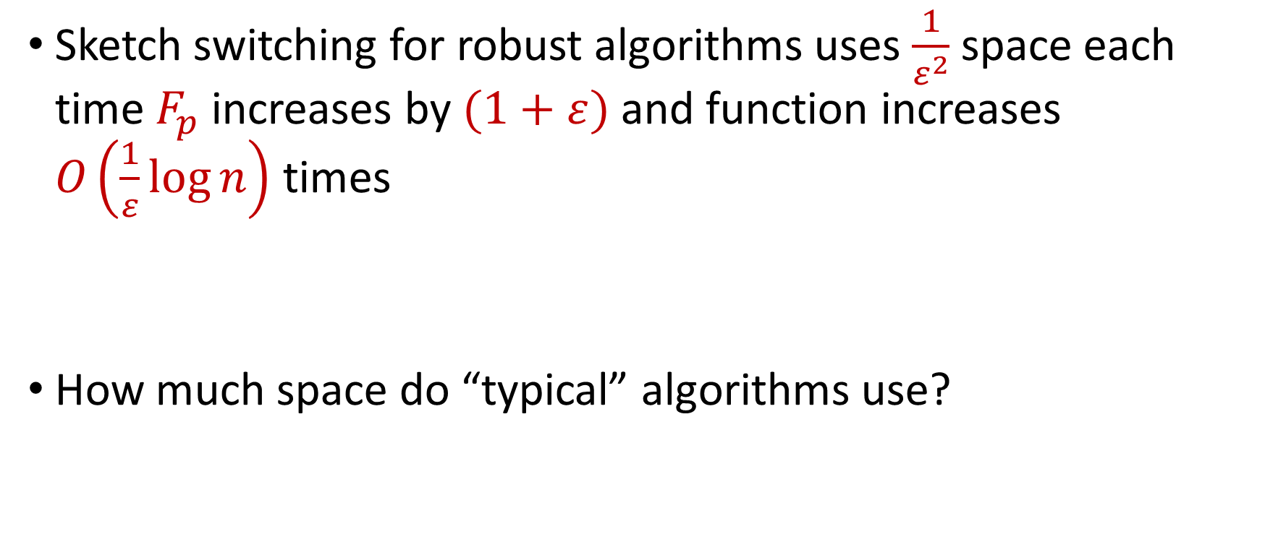
Sketch Switching Summary
Sketch switching for robust algorithms uses $\frac{1}{ε^{2}}$ space each time $F_{p}$ increases by $(1+ε)$ and function increases $O\left(\frac{1}{ε}\log{n}\right)$ times
How much space do “typical” algorithms use?

Slide 39
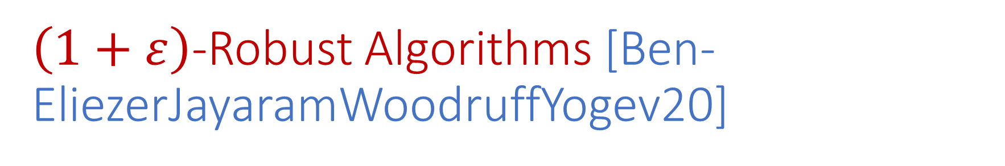
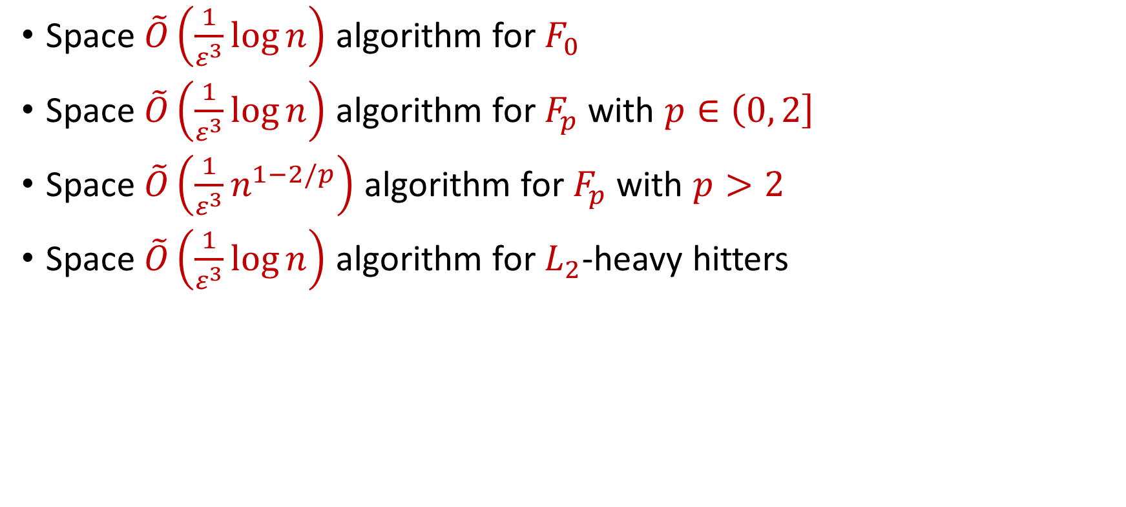
$\left(1+ε\right)$-Robust Algorithms [Ben-EliezerJayaramWoodruffYogev20]
Space $\tilde{O}\left(\frac{1}{ε^{3}}\log{n}\right)$ algorithm for $F_{0}$
Space $\tilde{O}\left(\frac{1}{ε^{3}}\log{n}\right)$ algorithm for $F_{p}$ with $p∈\left(0, 2\right]$
Space $\tilde{O}\left(\frac{1}{ε^{3}}n^{1−2/p}\right)$ algorithm for $F_{p}$ with $p>2$
Space $\tilde{O}\left(\frac{1}{ε^{3}}\log{n}\right)$ algorithm for $L_{2}$-heavy hitters
“A general framework that loses* nothing in $n$ and only $\frac{1}{ε}$ ”

Slide 40
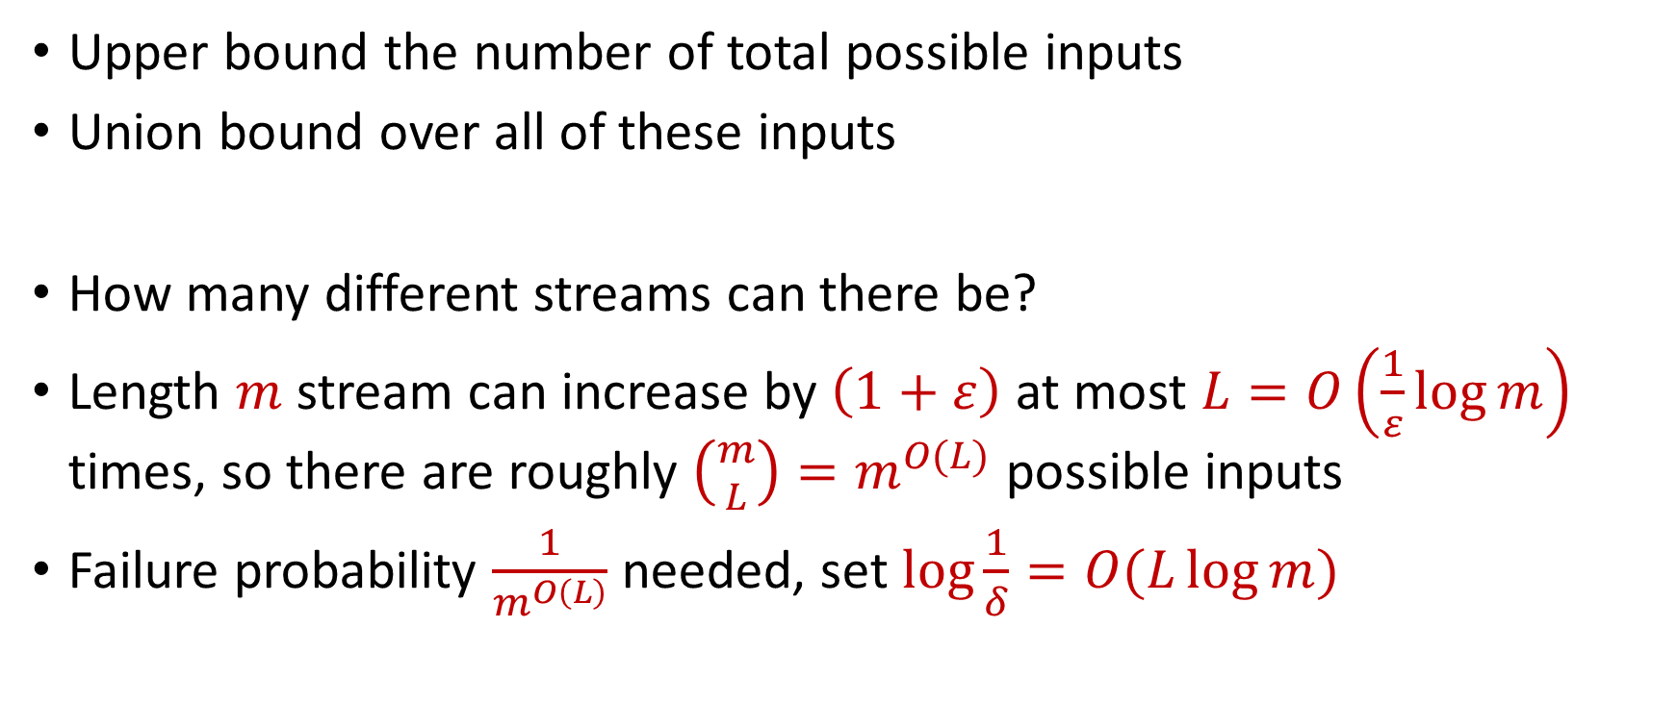
Computation Paths
Upper bound the number of total possible inputs
Union bound over all of these inputs
How many different streams can there be?
Length $m$ stream can increase by $\left(1+ε\right)$ at most $L=O\left(\frac{1}{ε}\log{m}\right)$ times, so there are roughly $\left({m \atop L}\right)=m^{O(L)}$ possible inputs
Failure probability $\frac{1}{m^{O\left(L\right)}}$ needed, set $\log{\frac{1}{δ}}=O(L\log{m})$

Slide 41
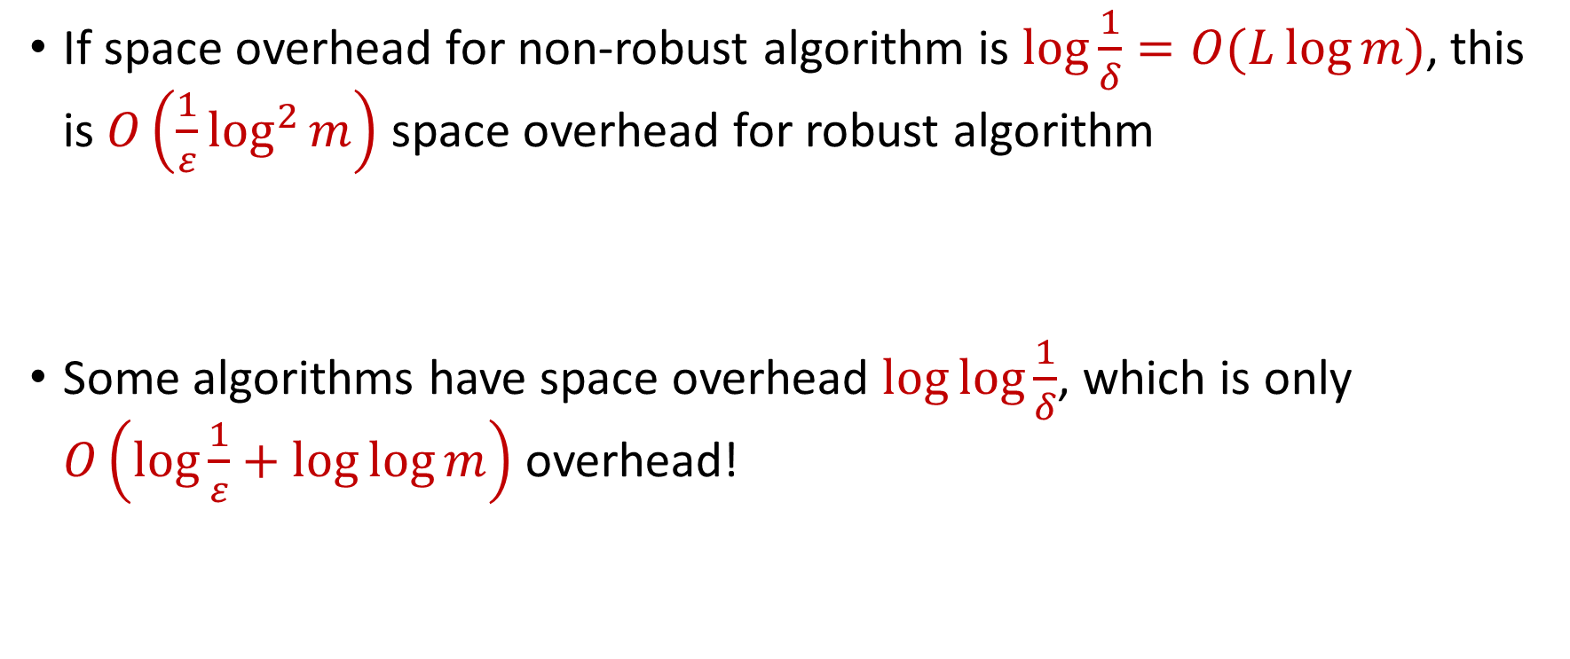
Computation Paths
If space overhead for non-robust algorithm is $\log{\frac{1}{δ}}=O(L\log{m})$, this is $O\left(\frac{1}{ε}\log^{2}{m}\right)$ space overhead for robust algorithm
Some algorithms have space overhead $\log{\log{\frac{1}{δ}}}$, which is only $O\left(\log{\frac{1}{ε}}+\log{\log{m}}\right)$ overhead!

Slide 42
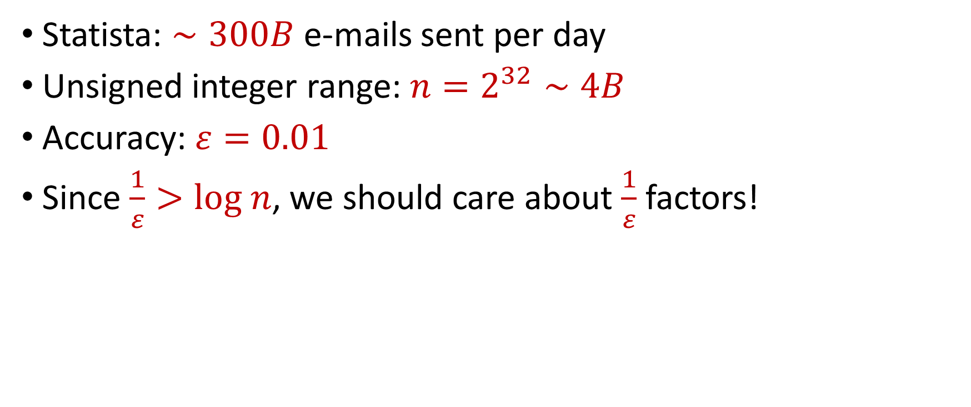
“What’s an epsilon between friends?
Statista: $∼300B$ e-mails sent per day
Unsigned integer range: $n=2^{32}∼4B$
Accuracy: $ε=0.01$
Since $\frac{1}{ε}>log n$, we should care about $\frac{1}{ε}$ factors!

Slide 43




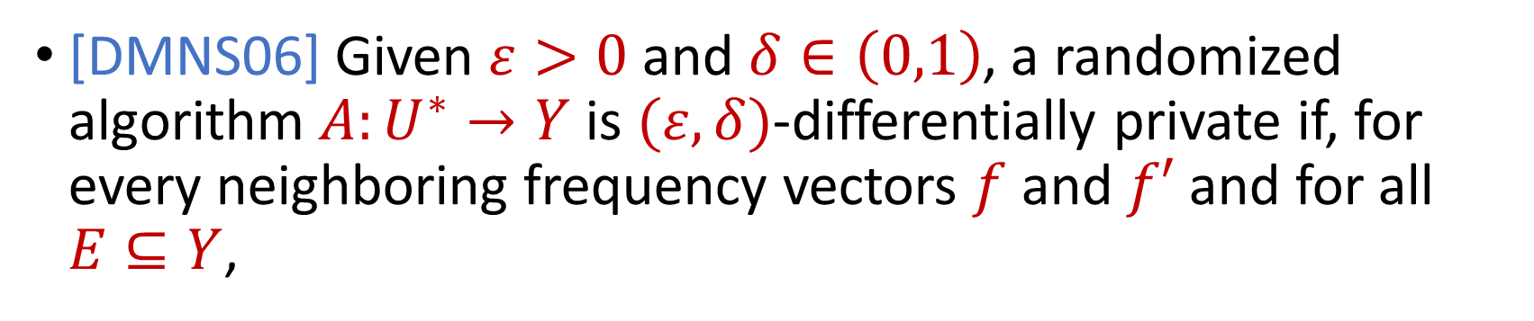

Differential Privacy
[DMNS06] Given $ε>0$and $δ∈\left(0,1\right)$, a randomized algorithm $A:U^{∗}→Y$ is $(ε,δ)$-differentially private if, for every neighboring frequency vectors $f$ and $f′$ and for all $E⊆Y$,
$$Pr\left[A\left(f\right)∈E\right]≤e^{ε}Pr\left[A\left(f^{′}\right)∈E\right]+δ$$
$$A\left( \right)≈A\left( \right)$$
Notes:
[DworkMcSherryNissimSmith06]

Slide 44
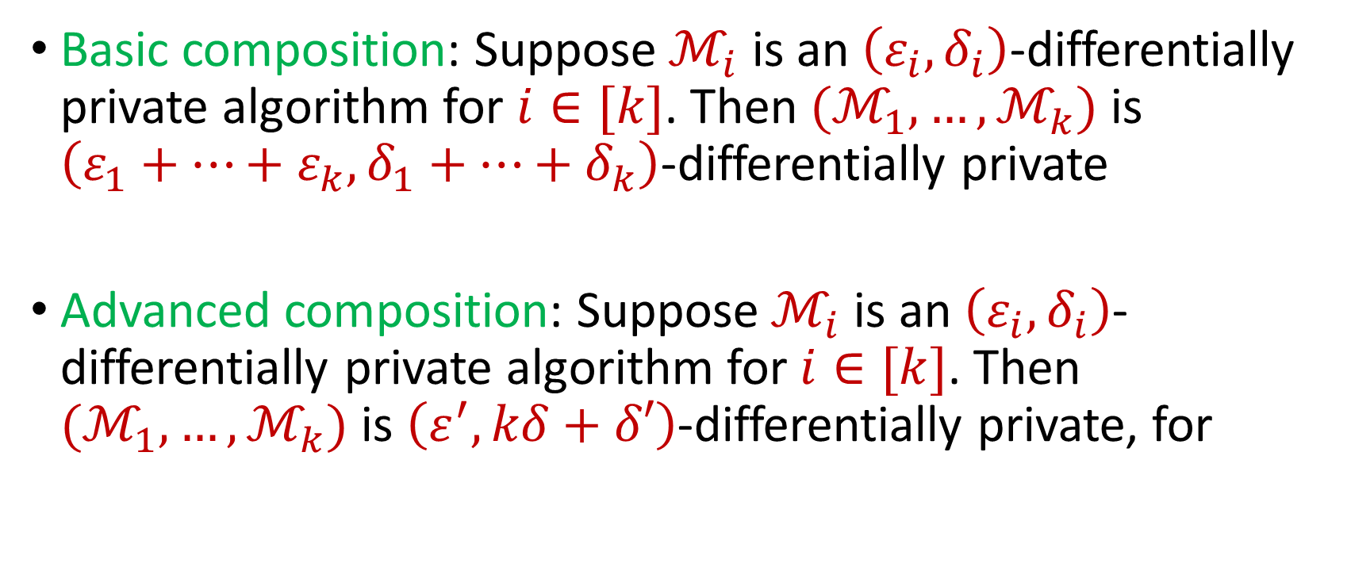
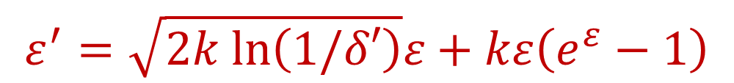
Composition Theorems
Basic composition: Suppose $ℳ_{i}$ is an $\left(ε_{i},δ_{i}\right)$-differentially private algorithm for $i∈[k]$. Then $(ℳ_{1},…,ℳ_{k})$ is $\left(ε_{1}+…+ε_{k},δ_{1}+…+δ_{k}\right)$-differentially private
Advanced composition: Suppose $ℳ_{i}$ is an $\left(ε_{i},δ_{i}\right)$-differentially private algorithm for $i∈[k]$. Then $(ℳ_{1},…,ℳ_{k})$ is $\left(ε^{′},kδ+δ′\right)$-differentially private, for
$$ε^{′}=\sqrt{2k ln\left(1/δ′\right)}ε+kε\left(e^{ε}−1\right)$$
Notes:
[DworkMcSherryNissimSmith06]

Slide 45
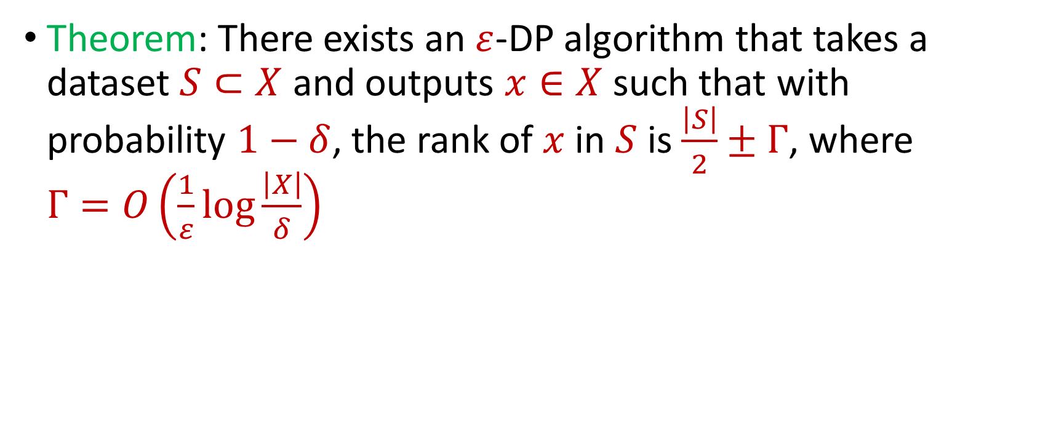
Private Median
Theorem: There exists an $ε$-DP algorithm that takes a dataset $S⊂X$ and outputs $x∈X$ such that with probability $1−δ$, the rank of $x$ in $S$ is $\frac{\left|S\right|}{2}±Γ$, where $Γ=O\left(\frac{1}{ε}\log{\frac{\left|X\right|}{δ}}\right)$
Notes:
[DworkMcSherryNissimSmith06]

Slide 46
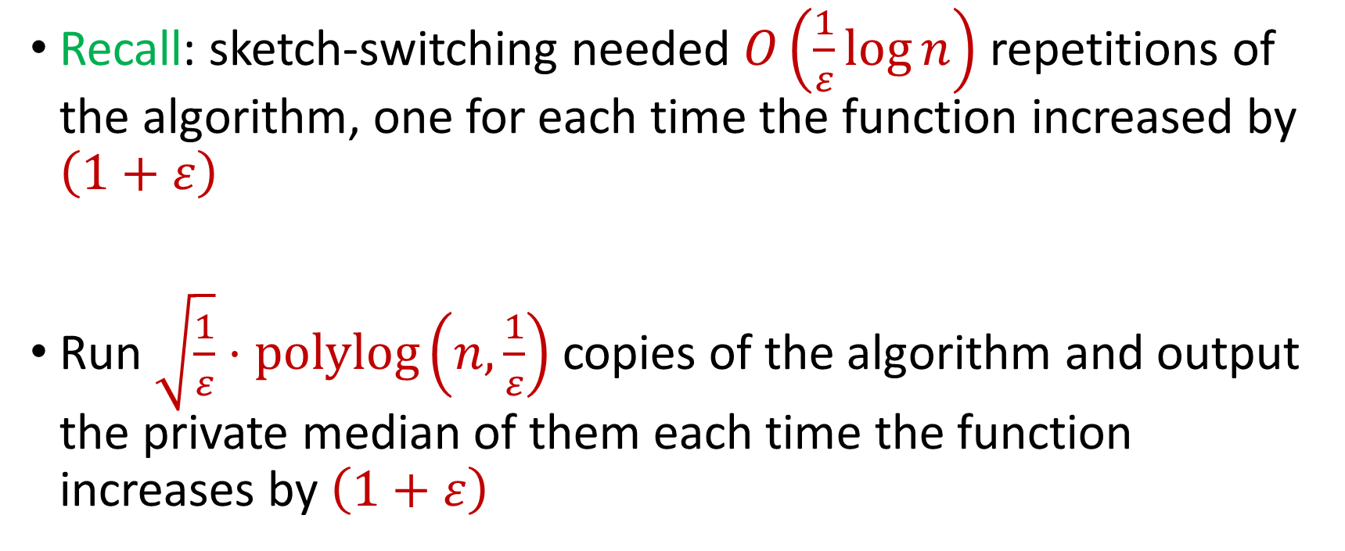
DP for Adversarial Robustness
Recall: sketch-switching needed $O\left(\frac{1}{ε}\log{n}\right)$ repetitions of the algorithm, one for each time the function increased by $\left(1+ε\right)$
Run $\sqrt{\frac{1}{ε}}⋅polylog\left(n,\frac{1}{ε}\right)$ copies of the algorithm and output the private median of them each time the function increases by $\left(1+ε\right)$
Notes:
[DworkMcSherryNissimSmith06]

Slide 47
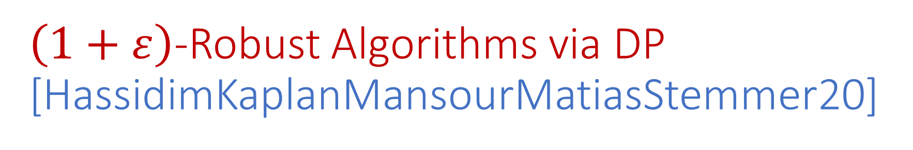
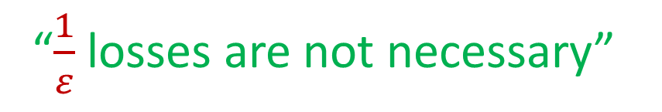
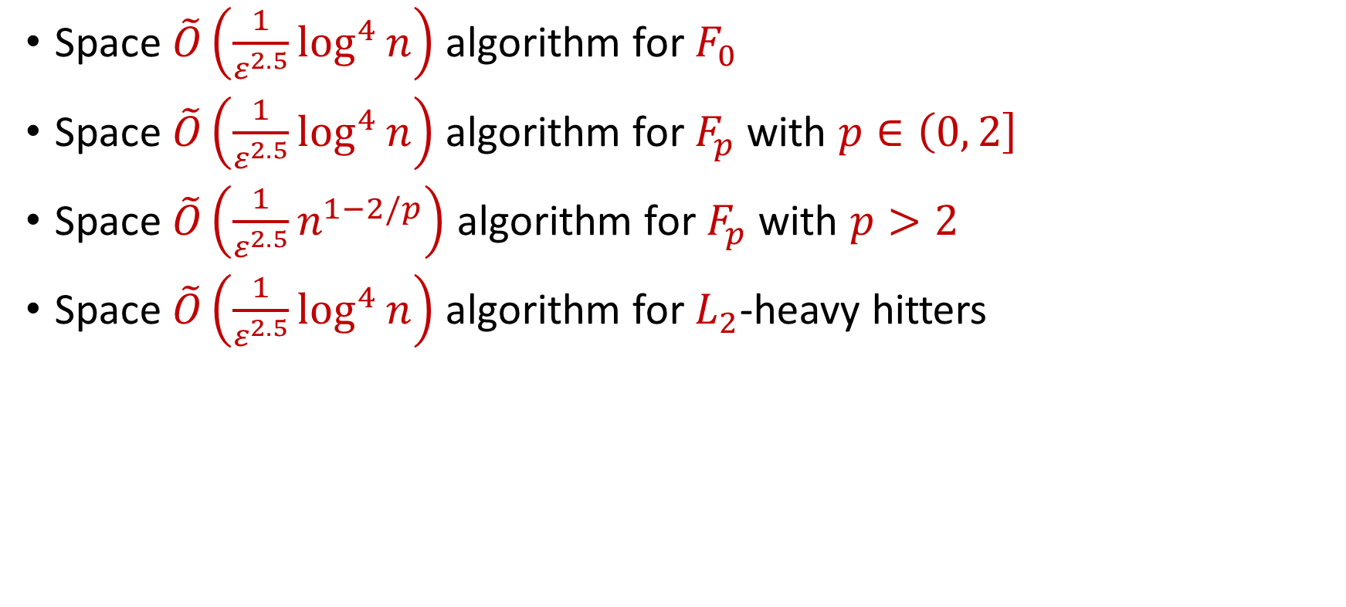
$\left(1+ε\right)$-Robust Algorithms via DP [HassidimKaplanMansourMatiasStemmer20]
Space $\tilde{O}\left(\frac{1}{ε^{2.5}}\log^{4}{n}\right)$ algorithm for $F_{0}$
Space $\tilde{O}\left(\frac{1}{ε^{2.5}}\log^{4}{n}\right)$ algorithm for $F_{p}$ with $p∈\left(0, 2\right]$
Space $\tilde{O}\left(\frac{1}{ε^{2.5}}n^{1−2/p}\right)$ algorithm for $F_{p}$ with $p>2$
Space $\tilde{O}\left(\frac{1}{ε^{2.5}}\log^{4}{n}\right)$ algorithm for $L_{2}$-heavy hitters
“$\frac{1}{ε}$ losses are not necessary”

Slide 48
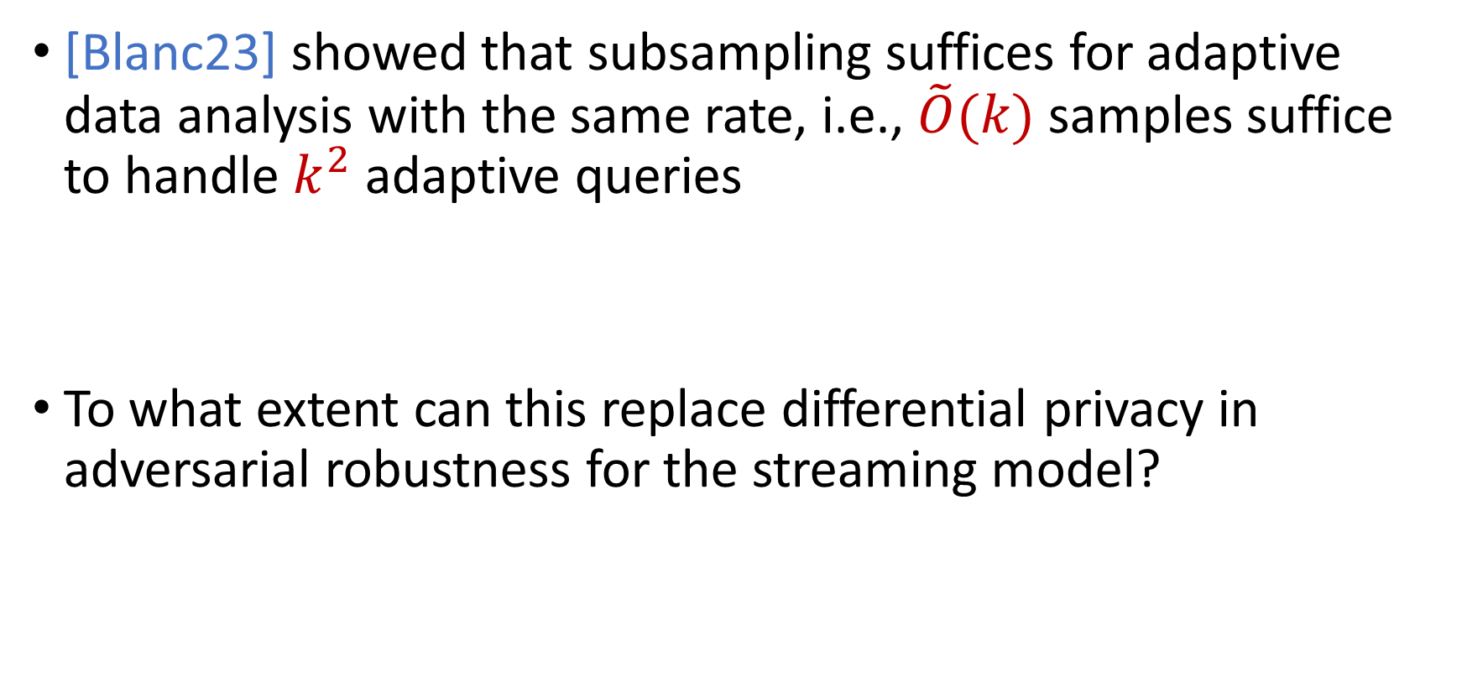
A Curious Question…
[Blanc23] showed that subsampling suffices for adaptive data analysis with the same rate, i.e., $\tilde{O}(k)$ samples suffice to handle $k^{2}$ adaptive queries
To what extent can this replace differential privacy in adversarial robustness for the streaming model?

Slide 49
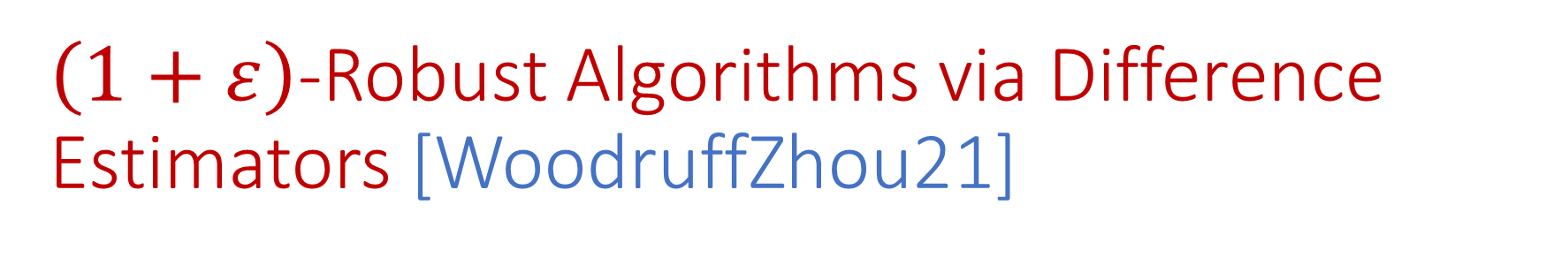
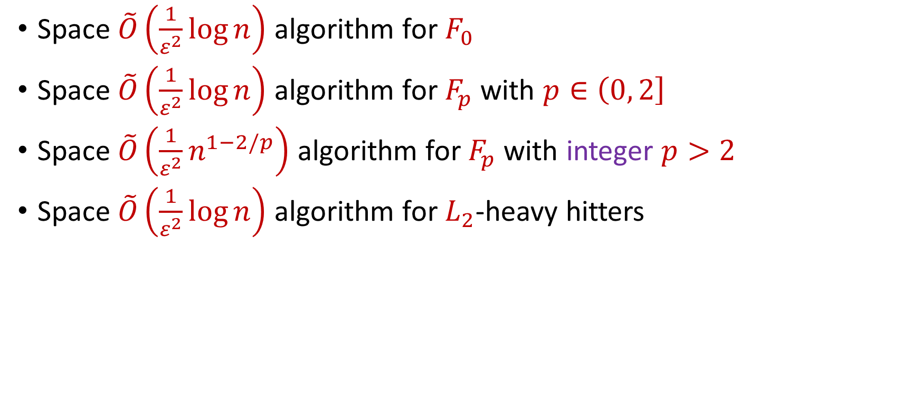
$\left(1+ε\right)$-Robust Algorithms via Difference Estimators [WoodruffZhou21]
Space $\tilde{O}\left(\frac{1}{ε^{2}}\log{n}\right)$ algorithm for $F_{0}$
Space $\tilde{O}\left(\frac{1}{ε^{2}}\log{n}\right)$ algorithm for $F_{p}$ with $p∈\left(0, 2\right]$
Space $\tilde{O}\left(\frac{1}{ε^{2}}n^{1−2/p}\right)$ algorithm for $F_{p}$ with integer $p>2$
Space $\tilde{O}\left(\frac{1}{ε^{2}}\log{n}\right)$ algorithm for $L_{2}$-heavy hitters
“No losses* are necessary!”

Slide 50


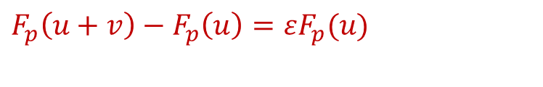




Difference Estimators Intuition
Do not need to pay $\frac{1}{ε^{2}}$ space each time $F_{p}$ increases by $(1+ε)$?
Only need constant factor approximation to $εF_{p}(u)$
Only need constant factor approximation to $F_{p}\left(u+v\right)−F_{p}\left(u\right)$
$F_{p}(u)$
Use difference estimator
$$u$$
$$u+v$$
$F_{p}\left(u+v\right)−F_{p}\left(u\right)=εF_{p}(u)$
$F_{p}(u+v)$
$$v$$

Slide 51
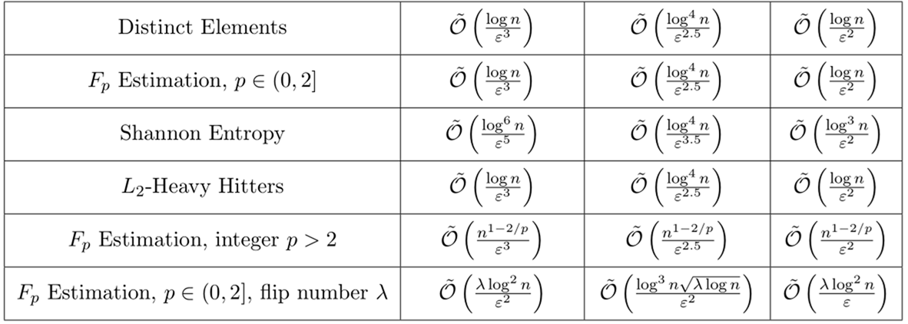
Summary
[BJWY20]
[HKMMS20]
[WY21]

Slide 52
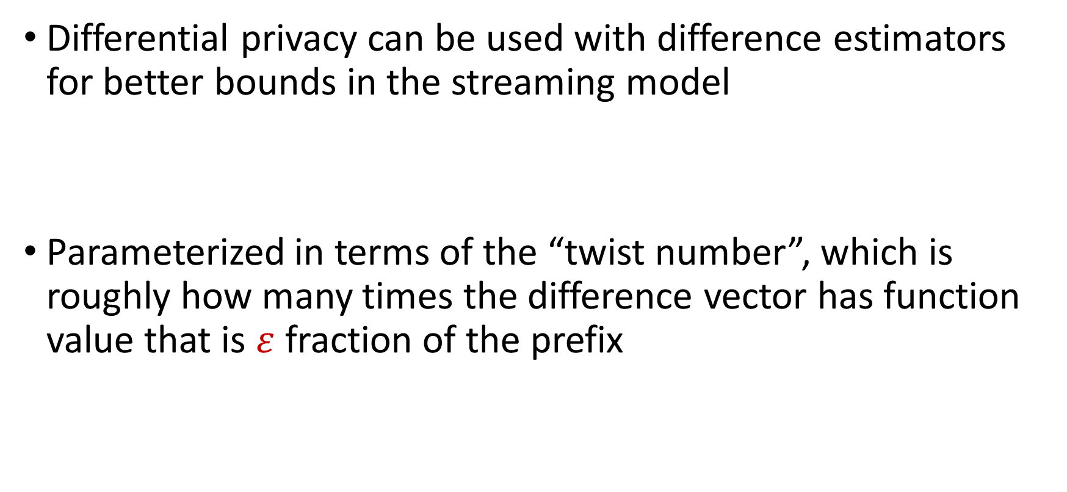
DP Strikes Back [AttiasCohenShechnerStemmer23]
Differential privacy can be used with difference estimators for better bounds in the streaming model
Parameterized in terms of the “twist number”, which is roughly how many times the difference vector has function value that is $ε$ fraction of the prefix

Slide 53
Sampling
Uniform sampling with a small overhead is robust for capturing the “density” of a dataset [Ben-EliezerYogev20]
Importance sampling is robust with various overheads [BravermanHassidimMattiasSchainSilwalZhou22, JiangPengWeinstein23, Kenneth-MordochSapir25]
Certain sampling algorithms are robust even to white-box adversaries

Slide 54
Separations
Separation between non-adaptive and adaptive streaming model, for black-box adversaries in the insertion-only setting for problems of:
Streaming Adaptive Data Analysis Problem (SADA) [KaplanMansourNissimStemmer21]
Graph Coloring [ChakrabartiGhoshStoeckl22]

Slide 55
White-Box Adversaries
The adversary has access not only to the previous outputs of the honest algorithm, but also to the entire internal state of the algorithm
Reductions to deterministic communication complexity protocols [AjtaiBravermanJayramSilwalWoodruffZhou22]
No non-trivial algorithms for many central problems
Can use crypto against time-bounded white-box adversaries

Slide 56
Many Other Beautiful Works
Attacks on classic data structures and algorithms:
[CohenLyuNelsonSarlosShechnerStemmer22], [CohenNelsonSarlosStemmer23], [CohenNelsonSarlosSinghalStemmer23], [AhmadianCohen24], [GribelyukLinWoodruffYuZhou24, 25]
Adapting classic data structures:
[CherapanamjeriNelson20], [CohenLyuNelsonSarlosShechnerStemmer22], [NaorOved22],

Slide 57
Future Directions
Capabilities and limitations for insertion-deletion streams?
Refining adversary models and interactions, e.g., computationally restricted adversaries (bounded time, space, etc.), delayed observations, partial visibility of randomness
Adversarial input in new problems and models, e.g., distributed monitoring, MPC

Slide 58


Any Questions?

Slide 59
Workshop Themes
What attacks are possible against classical data structure and algorithms? How efficient can we make them?
Xin, Mihir, Sara, Edith
What are the capabilities and limitations of robust data structures and algorithms in various models? How do different adversarial models change what’s possible?
Omri, Amit, Guy, David, Elena, Honghao
New problems and models of adversarial robustness
Uri, Binghui, Sandeep, Chen, Shenghao, Yuhan
Notes:
Let’s start by breaking down each of the terms in the title. To understand the sliding window model, we first have to understand the streaming model of computation, in which elements of an underlying data set S, arrive sequentially and the goal is to evaluate or approximate some given function on this dataset, using space sublinear in S. In the sliding window model, only the W most recent updates form the underlying data set

